Slide 1
Naturalizing the Dungeons and Dragons Experience via NLP
Zach Schickler
zachschickler@knights.ucf.edu
Blake Wyatt
blakewyatt@knights.ucf.edu
University of Central Florida Florida, United States CAP 6640 - Spring 2021

Slide 2
Problem Statement

Slide 3
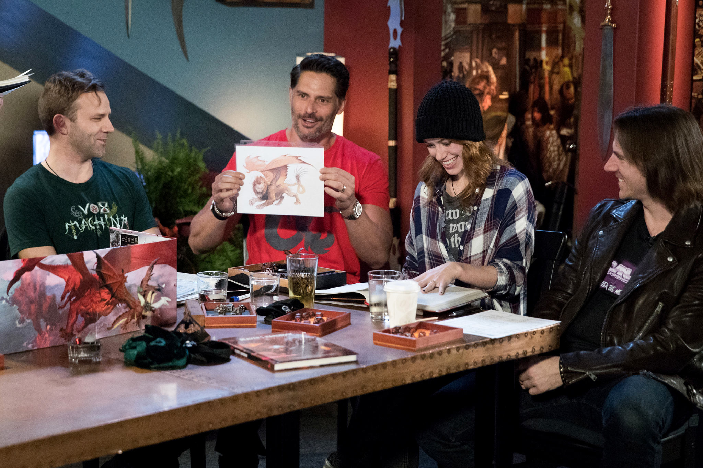

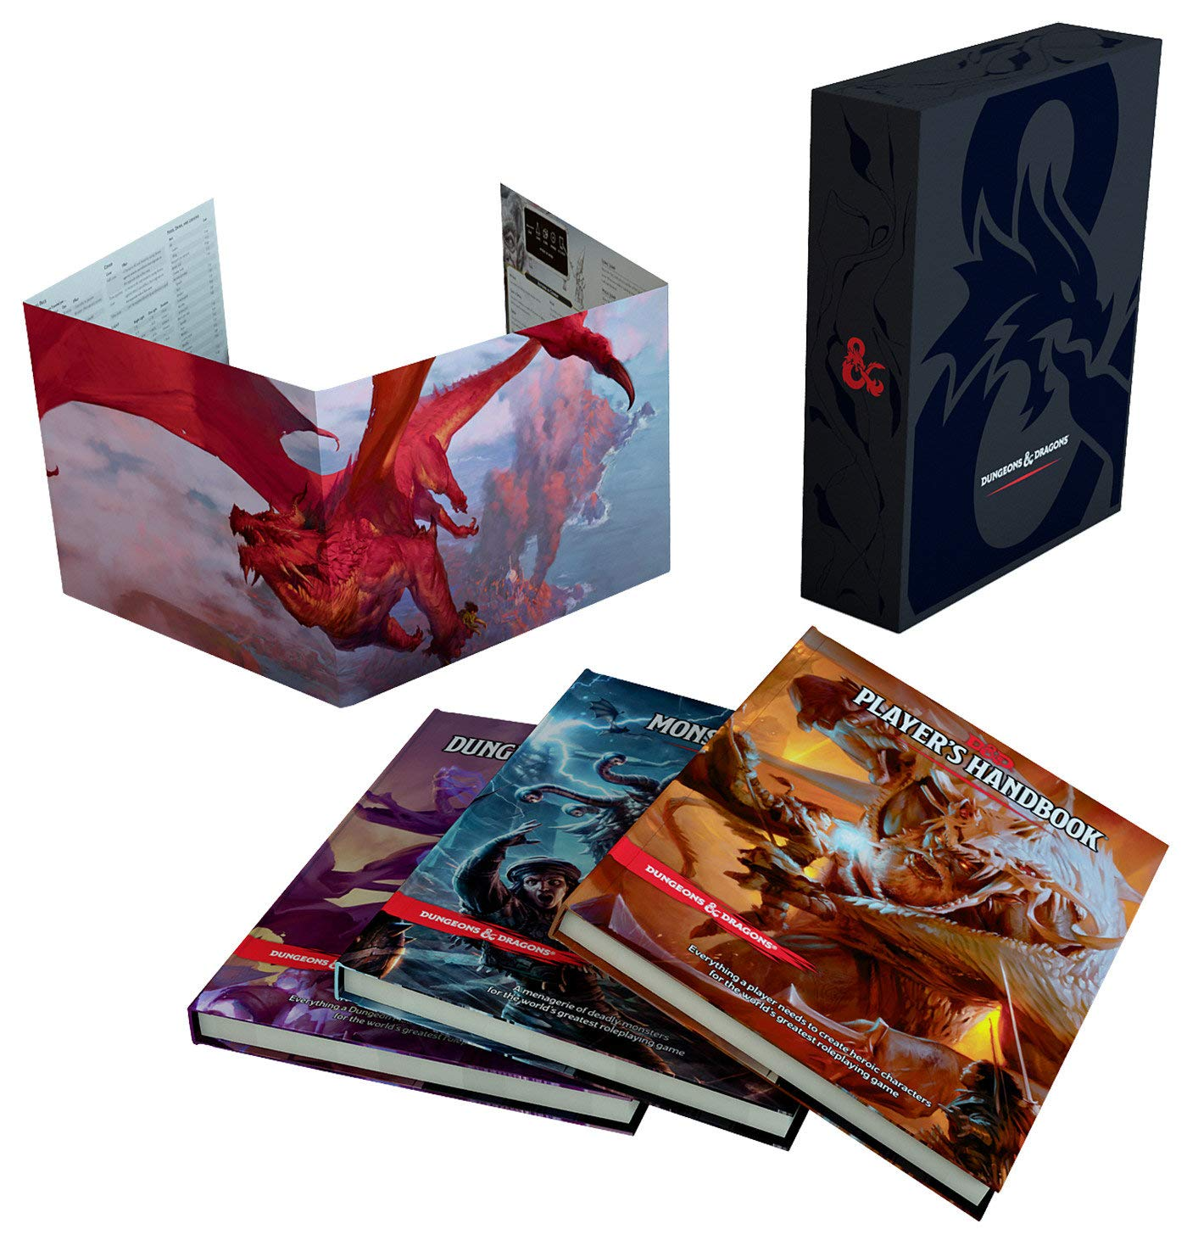
Problem
D&D has its roots as an in-person roleplaying game, and was designed around a distinct set of tools (Dice, Papers, Figurines).

Slide 4
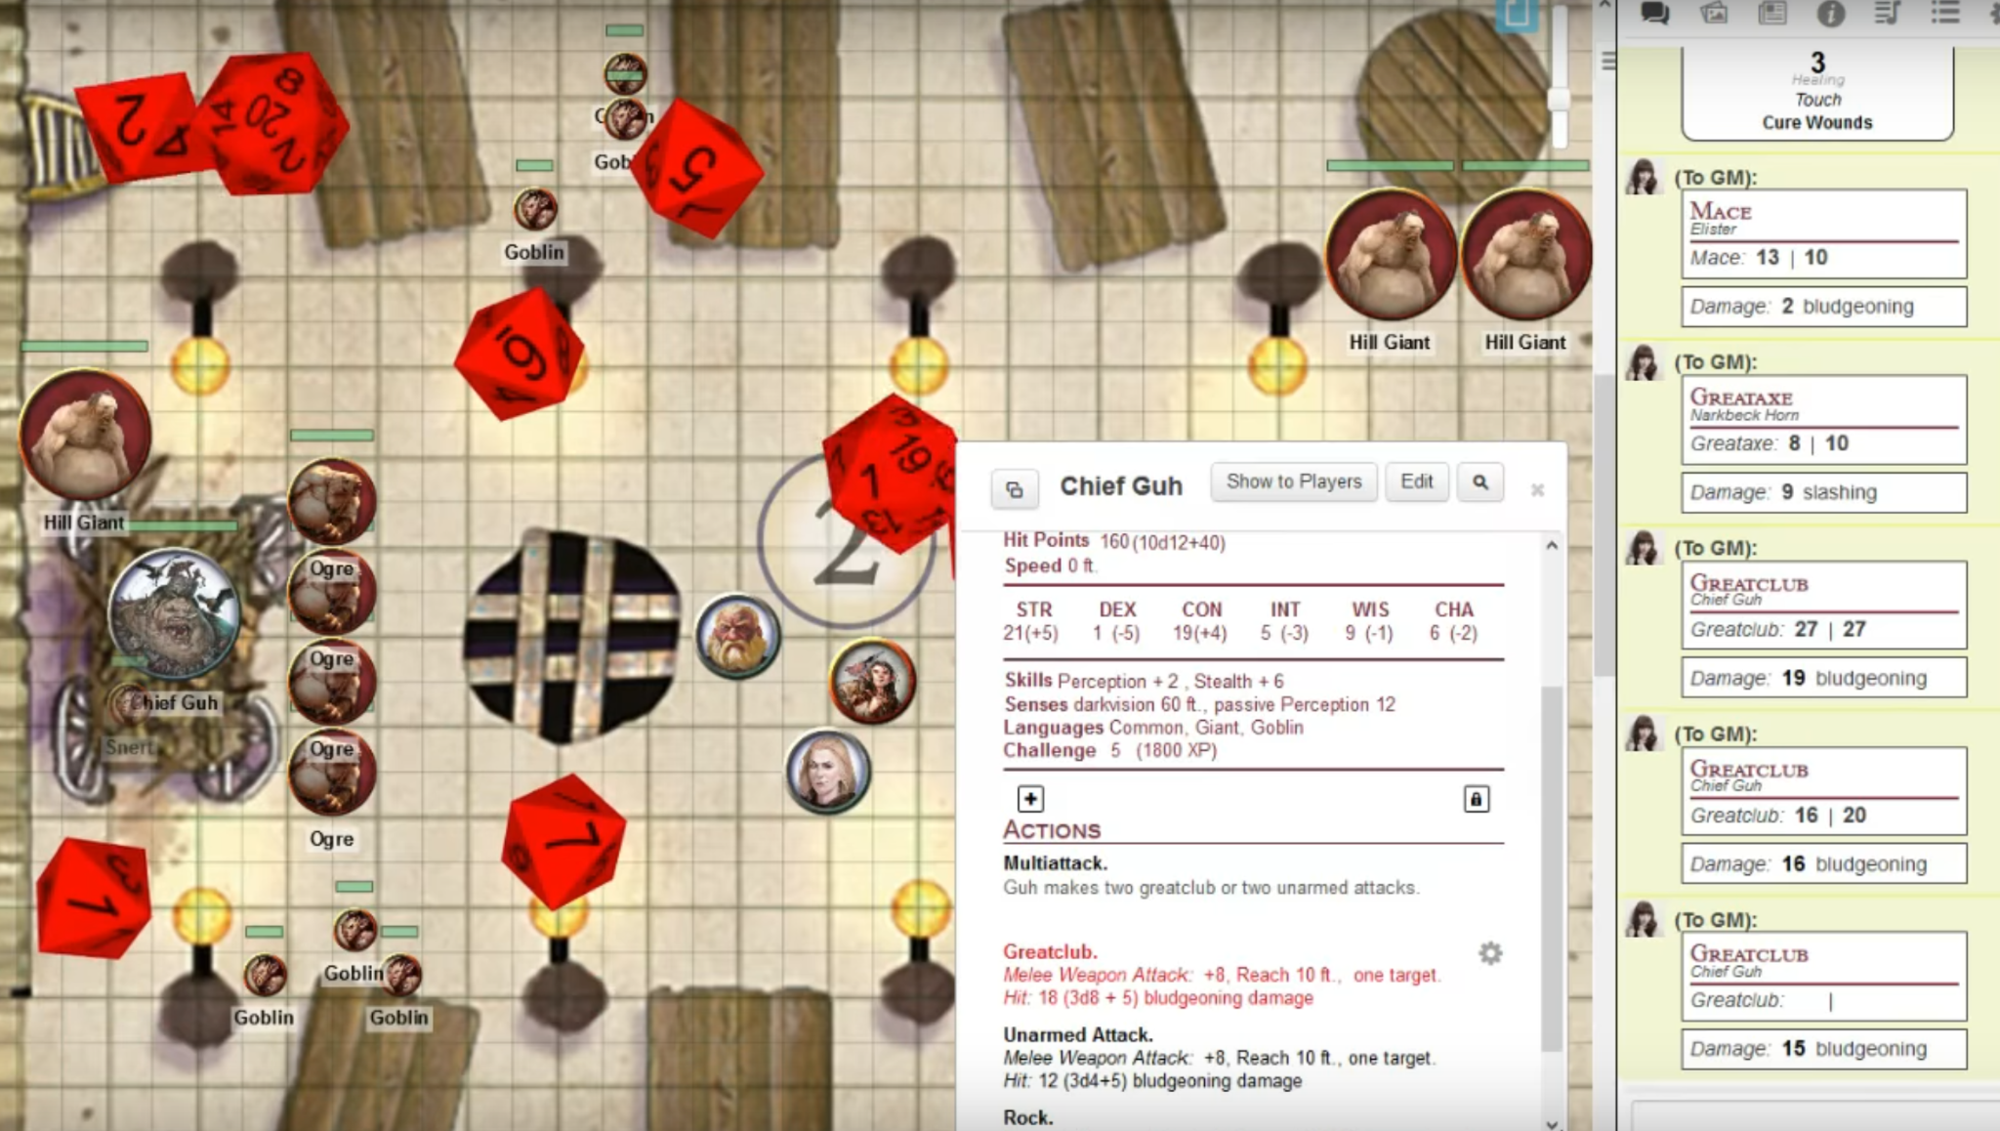
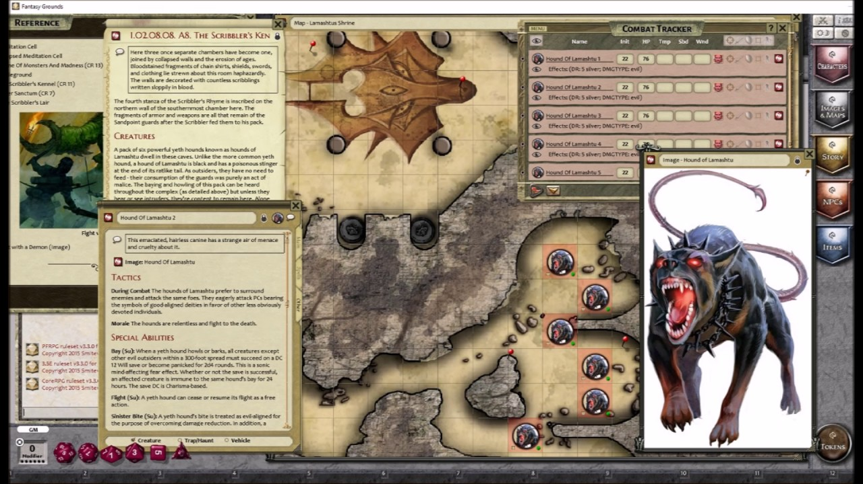
Problem
Several reasons to move online…
No coordinating meeting places.
Can play with people from longer distances.
Requires keeping less physical tools.
Cheaper.
One major reason not to…
IMMERSION.

Slide 5
Motivation
Automating the job of the Dungeon Master through NLP will allow for a smoother flow of the game when playing Dungeons and Dragons online, thus solving its primary issue and making online D&D more desirable over physical D&D.

Slide 6
Related Work

Slide 7
Related Work
Othman et al. classify types of opinions found in media.
Approach: tag opinionated words and have them carry a weight that gets factored in during categorization.
Tagging words can help in our task since some actions typically always feature certain parts of speech.
Example: Let’s head to the Tavern.
Classification: 1 - Moving
Othman, Mahmoud, et al. "Using NLP approach for opinion types classifier." (2015).

Slide 8
Pipeline and Methods

Slide 9
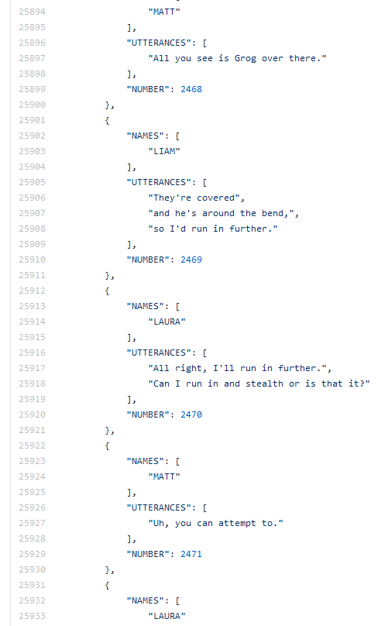
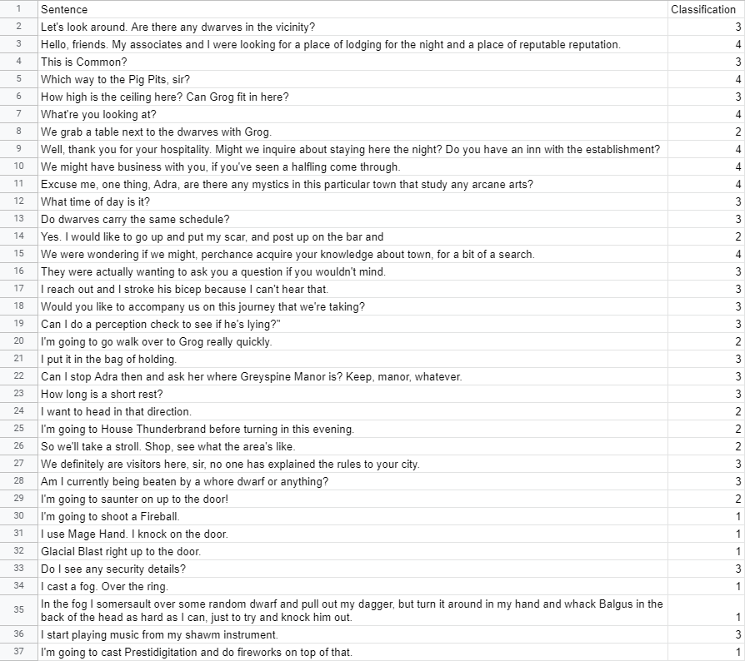
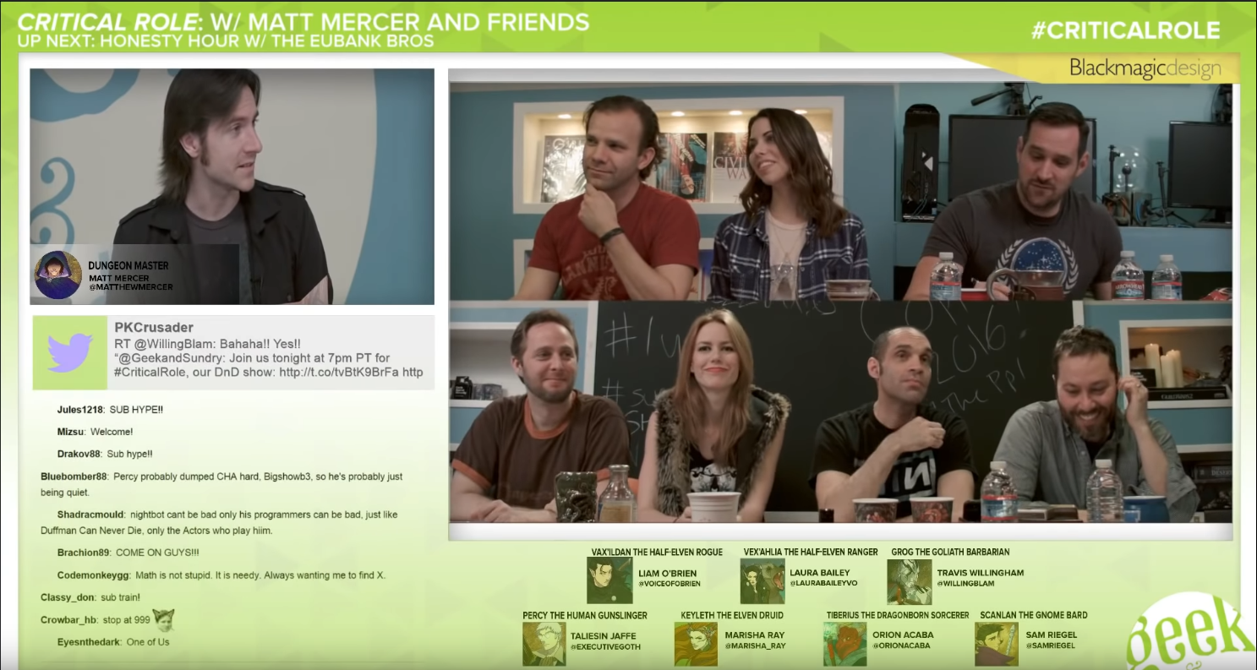
Dataset
Rameshkumar, Revanth, and Peter Bailey. "Storytelling with Dialogue: A Critical Role Dungeons and Dragons Dataset." Proceedings of the 58th Annual Meeting of the Association for Computational Linguistics. 2020.

Slide 10
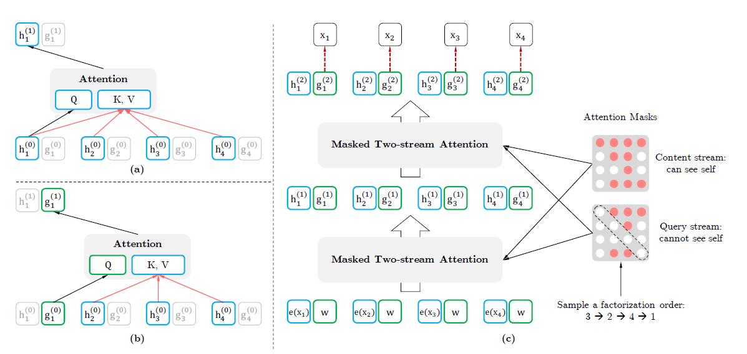
Transformer Networks
Yang, Zhilin, et al. "XLNet: Generalized autoregressive pretraining for language understanding." arXiv preprint arXiv:1906.08237 (2019).
Uses Attention: practice where more emphasis is put on smaller, more important parts of input.
Transformer Networks are very effective for text classification, so we have chosen to use several state-of-the-art networks.

Slide 11
Evaluation

Slide 12
Evaluation Methods
BERT (B)idirectional (E)ncoder (R)epresentations from (T)ransformers
Devlin, Jacob, et al. "Bert: Pre-training of deep bidirectional transformers for language understanding." arXiv preprint arXiv:1810.04805 (2018).
You can take a pre-trained BERT model and fine tune with one additional output layer to make a state-of-the-art text classification model.
XLNet
Yang, Zhilin, et al. "Xlnet: Generalized autoregressive pretraining for language understanding." arXiv preprint arXiv:1906.08237 (2019).
Autoregressive formulation used by Xlnet is meant to overcome the pretrain-finetune dependency of BERT. It is expected to slightly outperform BERT.
XLM
Lample, Guillaume, and Alexis Conneau. "Cross-lingual language model pretraining." arXiv preprint arXiv:1901.07291 (2019).
XLM aims to make use of the newfound efficiency from generative pretraining for English NLP tasks.
RoBERTa
Liu, Yinhan, et al. "Roberta: A robustly optimized bert pretraining approach." arXiv preprint arXiv:1907.11692 (2019).
BERT’s performance suffers due to undertraining and poorly chosen hyperparameters. RoBERTa fixes these two problems to make BERT achieve results comparable to other models.
DistilBERT
Sanh, Victor, et al. "DistilBERT, a distilled version of BERT: smaller, faster, cheaper and lighter." arXiv preprint arXiv:1910.01108 (2019).
Using BERT as a starting point, DistilBERT makes a lighter version of BERT that is cheaper to run.
Notes:
BERT - You can take a pre-trained BERT model and fine tune with one additional output layer to make a state-of-the-art text classification model.
Xlnet - Autoregressive formulation used by Xlnet is meant to overcome the pretrain-finetune dependency of BERT. It is expected to slightly outperform BERT.
XLM - XLM aims to make use of the newfound efficiency from generative pretraining for English NLP tasks.
RoBERTa - BERT’s performance suffers due to undertraining and poorly chosen hyperparameters. RoBERTa fixes these two problems to make BERT achieve results comparable to other models.
DistilBERT - Using BERT as a starting point, DistilBERT makes a lighter version of BERT that is cheaper to run.

Slide 13
Results

Slide 14
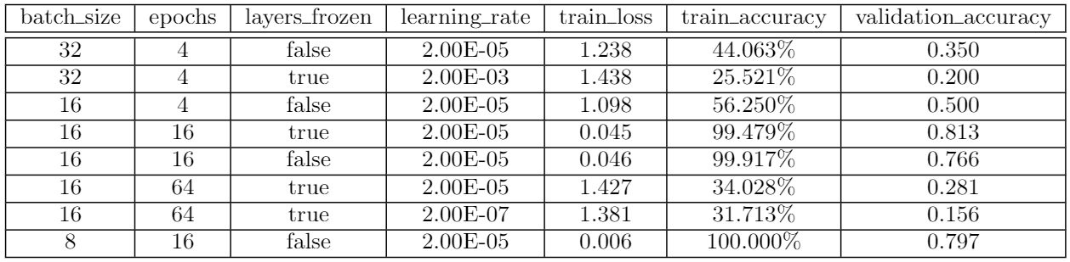
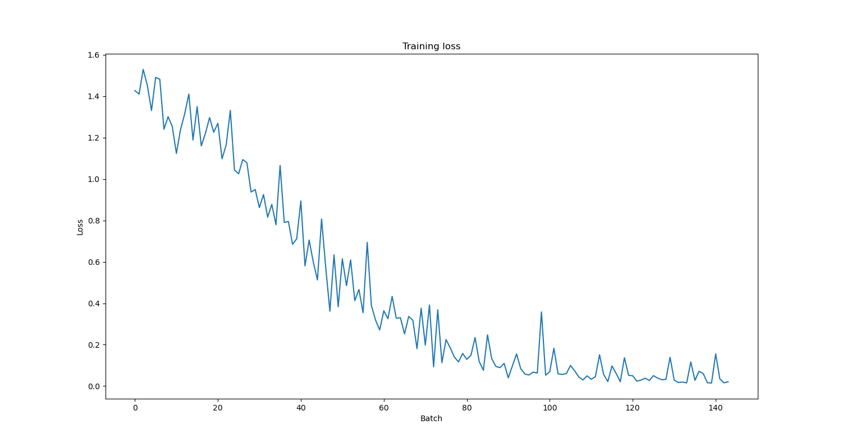
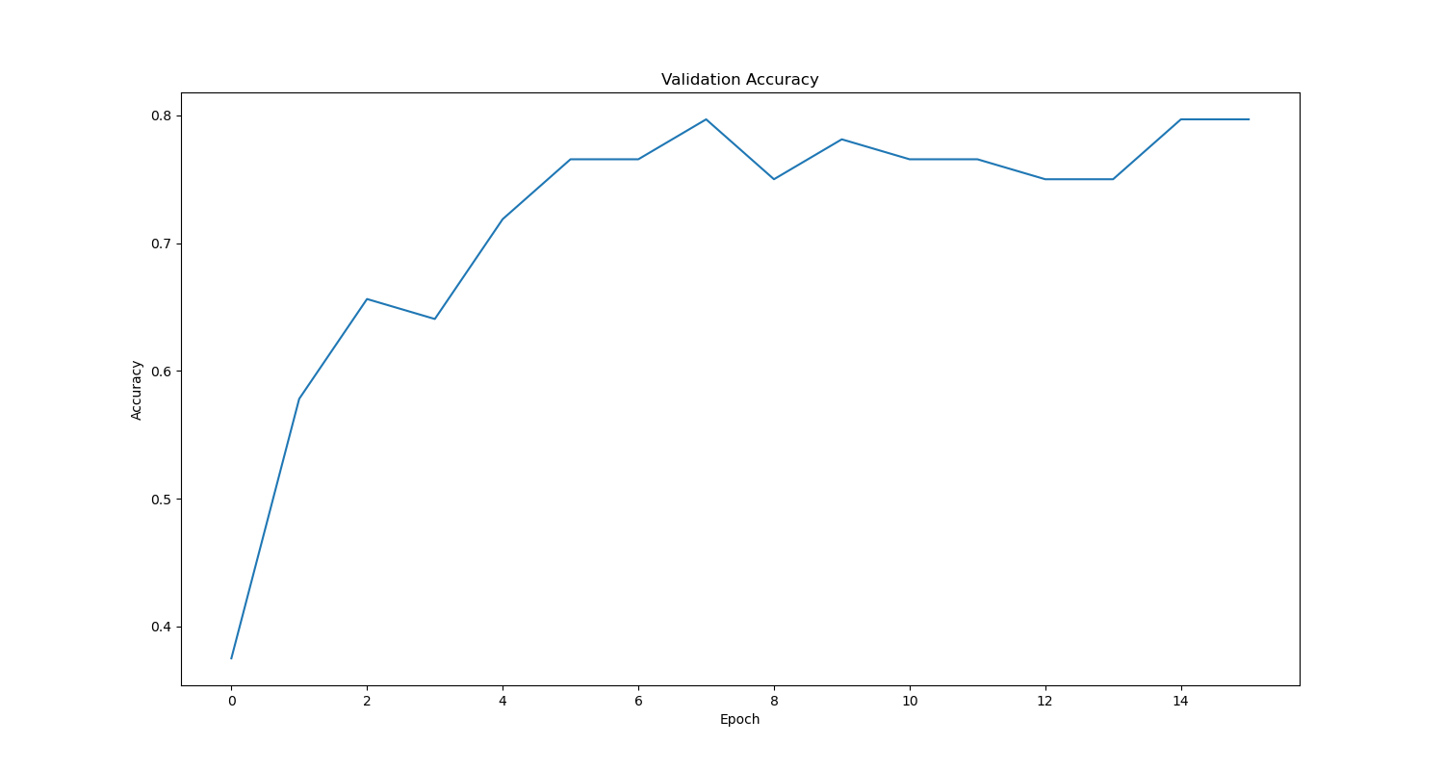
Results

Slide 15
Distribution of Work

Slide 16
Distribution of Work
Zach
Found data and manually parsed it for use.
Researched different transformer models and provided motivations for selection.
Provided data analysis, presentation, and conclusions.
Blake
Implemented transfer learning text classification solution.
Ran experiments to generate statistics.
Debugged issues in existing model.

Slide 17
Conclusion

Slide 18
Conclusions
Underestimated data needed, but hard to get large amounts.
Possible overfitting, but also likely the result of model picking up key words.
Surprisingly, despite game depending on natural speech, similar actions were phrased very similarly.
Model reached some level of success, showing that a fully developed game tool is feasible.
Possible next step: attempting experiments with other good model candidates.

Slide 19
Q & A

